Slide 1

Support for Climate Resilience and Livelihood Improvement in Coastal West Bengal
Sri Ramakrishna Rural Welfare Foundation

Slide 2

Introduction
The coastal districts of North and South 24 Parganas in West Bengal are highly vulnerable to the adverse impacts of climate change, including rising sea levels, increasing frequency of natural disasters, and loss of biodiversity. Natural disasters like Aila, tornadoes, tsunamis, and most recently, Cyclone Yash, have left many families homeless and struggling to rebuild their lives.

Slide 3

Our Mission
To enhance coastal resilience and improve the livelihoods of affected communities in West Bengal. Our focus is on long-term sustainable development in vulnerable regions, ensuring that communities are better prepared for future challenges.

Slide 4

Project Objectives
1. Afforestation: Planting native tree species to prevent soil erosion, enhance biodiversity, and combat climate change.
2. Sustainable Development: Promoting sustainable agricultural practices and alternative livelihoods to reduce dependency on natural resources.
3. Shelter Provision: Constructing disaster-resilient homes for families displaced by natural disasters.

Slide 5
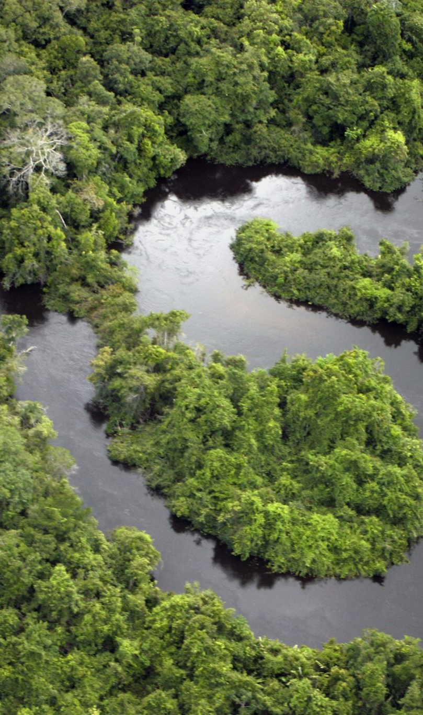
Target Areas
The project will focus on the following areas:
- Sandeshkhali
- Sundarbans
- Other vulnerable regions in North and South 24 Parganas.

Slide 6

Beneficiaries
The project aims to uplift the lives of poor families affected by natural disasters in the coastal regions of North and South 24 Parganas, ensuring that they have access to safer homes, sustainable livelihoods, and a resilient environment.

Slide 7
How You Can Help
Your donations will contribute to:
- Afforestation initiatives to combat climate change.
- Sustainable development projects that reduce dependency on natural resources.
- Building disaster-resilient homes for displaced families.
We invite you to partner with us to make a significant impact in the lives of these vulnerable communities.

Slide 8

Donation Details
Account Name: Sri Ramakrishna Rural Welfare Foundation
Bank Name: Punjab National Bank
Account Number: 3910002101009295
IFSC Code: PUNB0391000
Branch: Barasat (West Bengal)

Slide 9
Benefits of Partnership
By partnering with us, you will:
- Enhance your Corporate Social Responsibility (CSR) profile.
- Receive tax benefits associated with your donation.
- Contribute to a sustainable and resilient future for the coastal communities of West Bengal.

Slide 10

Conclusion
Thank you for considering our request. We look forward to the possibility of working together to create a sustainable and resilient future for the coastal communities of North and South 24 Parganas.
For more information, please contact us at sriramakrishnavivekananda2023@gmail.com
https://www.srrwf.org.in riramakrishnavivekananda2023@gm

