Slide 1
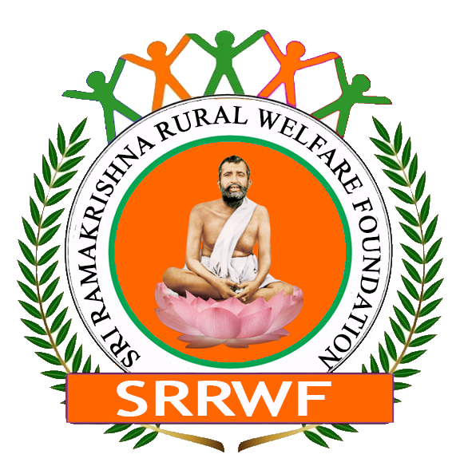

Requesting Donation for Pure Drinking Water Supply
Sundarban Coastal Areas | Sri Ramakrishna Rural Welfare Foundation (SRRWF)

Slide 2
Project Details
Project Name: Pure Drinking Water Supply for Sundarban Coastal Areas
NGO Name: Sri Ramakrishna Rural Welfare Foundation (SRRWF)
Location: Sundarban, West Bengal
Duration: 24 months (extendable)

Slide 3
Project Objectives
Provide access to safe and clean drinking water to Sundarban communities.
Install deep tube wells and promote rainwater harvesting.
Raise awareness of waterborne diseases and hygiene practices.
Ensure sustainable water management through community involvement.
Assess and improve water quality using scientific data.

Slide 4
Project Activities
Key Activities:
Community Needs Assessment: Baseline survey of water access and quality.
Water Quality Assessment: Analyze groundwater samples.
Deep Tube Well Installation: Set up in high-demand areas.
Rainwater Harvesting: Install systems to reduce groundwater reliance.
Community Awareness Campaigns: Workshops on hygiene and clean water.
Pipeline Supply: Explore treated surface water supply.

Slide 5
Resources and Budget
Deep Tube Well Installation: 20 lakhs per well
Water Quality Testing Kits: 1 lakh per kit
Rainwater Harvesting: 5 lakhs per system
Awareness Campaigns: 50,000 per campaign
Total Estimated Budget: 1 crore INR

Slide 6
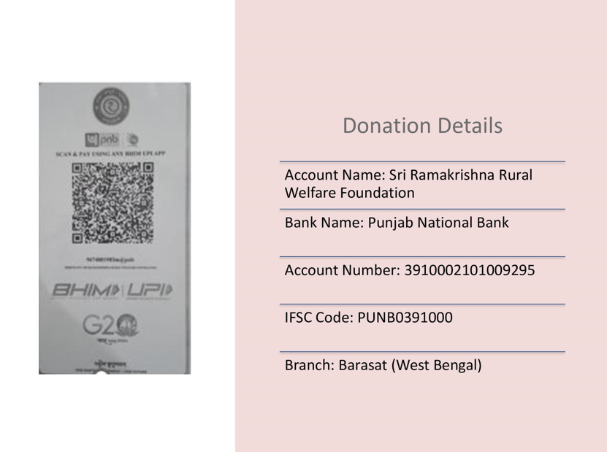
Bank Details for Donation

Slide 7
Monitoring & Evaluation
Water Quality Tests: Quarterly testing to track improvements.
Community Health Indicators: Reduction in waterborne diseases.
Community Feedback: Surveys on satisfaction with water systems.
Sustainability Metrics: Assess rainwater harvesting effectiveness.

Slide 8
Expected Outcomes
Access to clean water for over 50,000 people.
50% reduction in waterborne diseases.
Sustainable water management through community engagement.
Long-term water solutions (rainwater harvesting, treated surface water).

Slide 9
Sustainability Plan
Community-led maintenance and management of water systems.
Corporate & Govt collaboration for water quality testing and support.
Training community leaders for long-term sustainability.

