Slide 1
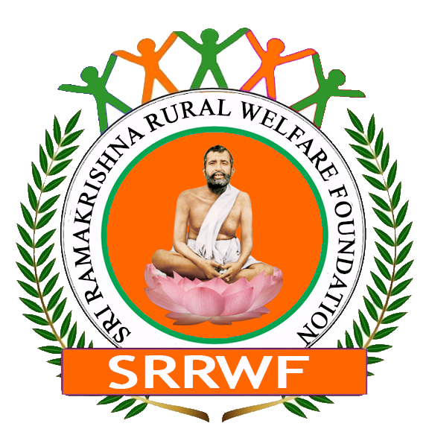
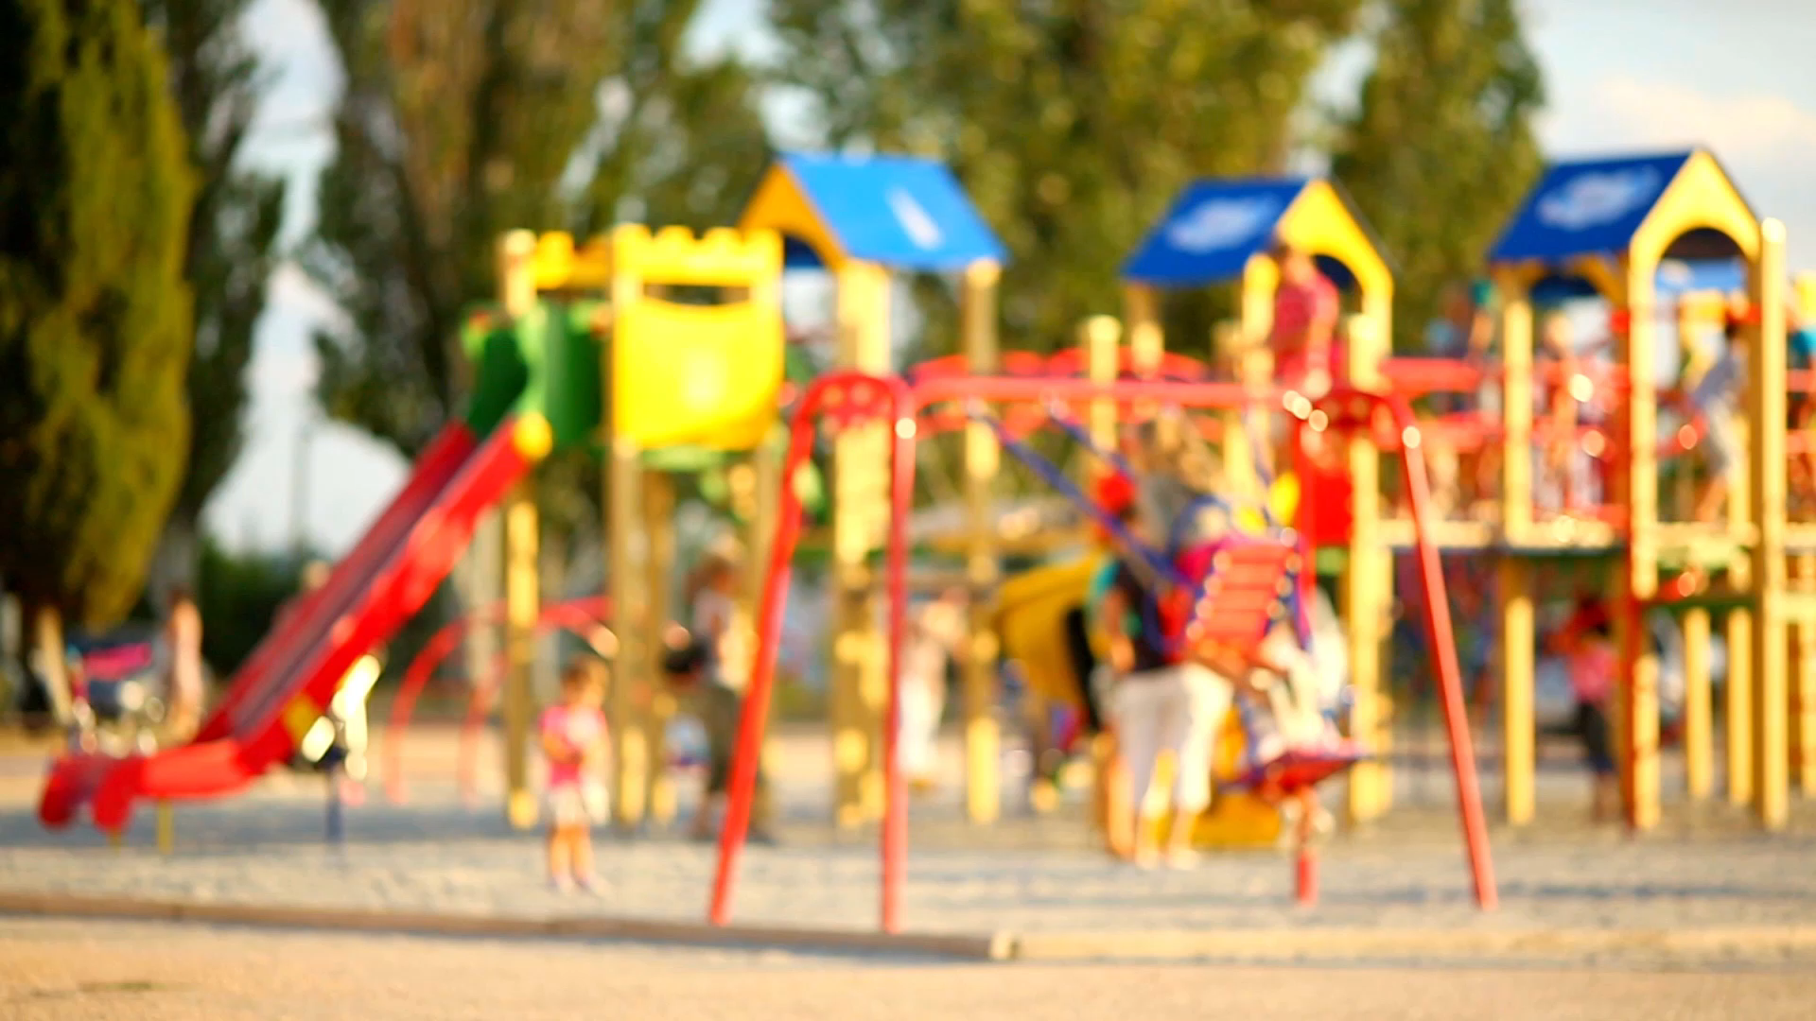
Objective:
To improve child health and immunization in the Sundarbans, focusing on impoverished communities.
To mitigate geographical, climatic, and economic barriers to child healthcare.
Sri Ramakrishna Rural Welfare Foundation

Slide 2

Background
Overview of the Sundarbans:
Unique biosphere with over 100 islands.
Population: ~4.5 million, primarily engaged in agriculture, fishing, and forest products.
Challenges: Geographic inaccessibility, climatic adversity, economic vulnerability.

Slide 3

Current Child Health Status
Vulnerability Factors:
Poor accessibility to healthcare.
High incidence of preventable diseases.
Low levels of immunization coverage.
Malnutrition and stunted growth.

Slide 4

Importance of the First 1,000 Days
Critical Window:
From conception to a child's second birthday.
Impacts cognitive development, future productivity, and overall well-being.
Investment in this period leads to long-term societal benefits.

Slide 5

Project Goals and Objectives
Primary Goal: Improve child health and immunization rates in the Sundarbans.
Specific Objectives:
Increase immunization coverage.
Reduce child mortality and morbidity.
Promote awareness about child health and immunization.
Collaborate with local communities and healthcare providers.

Slide 6
Target Population
Focus:
Children under the age of 5.
Pregnant women and new mothers.
Families living below the poverty line.

Slide 7
Key Challenges
Geographical Challenges:
Difficult terrain and lack of infrastructure.
Economic Barriers:
High poverty rates, limited access to healthcare.
Climatic Challenges:
Frequent natural disasters (cyclones, floods).

Slide 8

Strategy and Approach
Approach:
  Healthcare Access: Mobile health clinics, community health workers.
  Immunization Drives: Regular vaccination camps, door-to-door campaigns.
  Nutrition Programs: Distribution of supplements, education on nutrition.
  Community Engagement: Workshops, collaboration with local leaders.

Slide 9

Partnerships and Collaborations
Key Stakeholders:
  Local government health departments.
  NGOs and international health organizations.
  Community leaders and healthcare workers.
  Educational institutions for awareness programs.

Slide 10
Implementation Plan
Phase 1: Assessment
Conduct baseline surveys on child health and immunization status.
Phase 2: Planning
Develop tailored intervention plans for different regions.
Phase 3: Execution
Launch immunization drives, health camps, and educational programs.
Phase 4: Monitoring and Evaluation
Regular monitoring, data collection, and impact assessment.

Slide 11

Budget and Resource Allocation
Budget Breakdown:
Healthcare personnel: $50000
Immunization supplies: $80000
Transportation (Mobile Clinics): $70000
Community Programs: $75000
Funding Sources:
Government grants, international aid, private donations.

Slide 12

Monitoring and Evaluation
Key Metrics:
  Immunization coverage rates.
  Reduction in child morbidity/mortality.
  Improvement in nutritional status.
  Community participation and awareness levels.
Tools and Methods:
  Surveys, health records, focus groups, interviews.

Slide 13

Risk Management
Potential Risks:
  Natural disasters disrupting activities.
  Resistance from local communities.
  Shortage of medical supplies.
Mitigation Strategies:
  Develop contingency plans, build local trust, ensure supply chain reliability.

Slide 14
Expected Outcomes
Short-term:
Improved immunization coverage and child health.
Long-term:
Healthier, more resilient communities.
Reduction in child mortality and morbidity.
Enhanced overall development in the region.

Slide 15
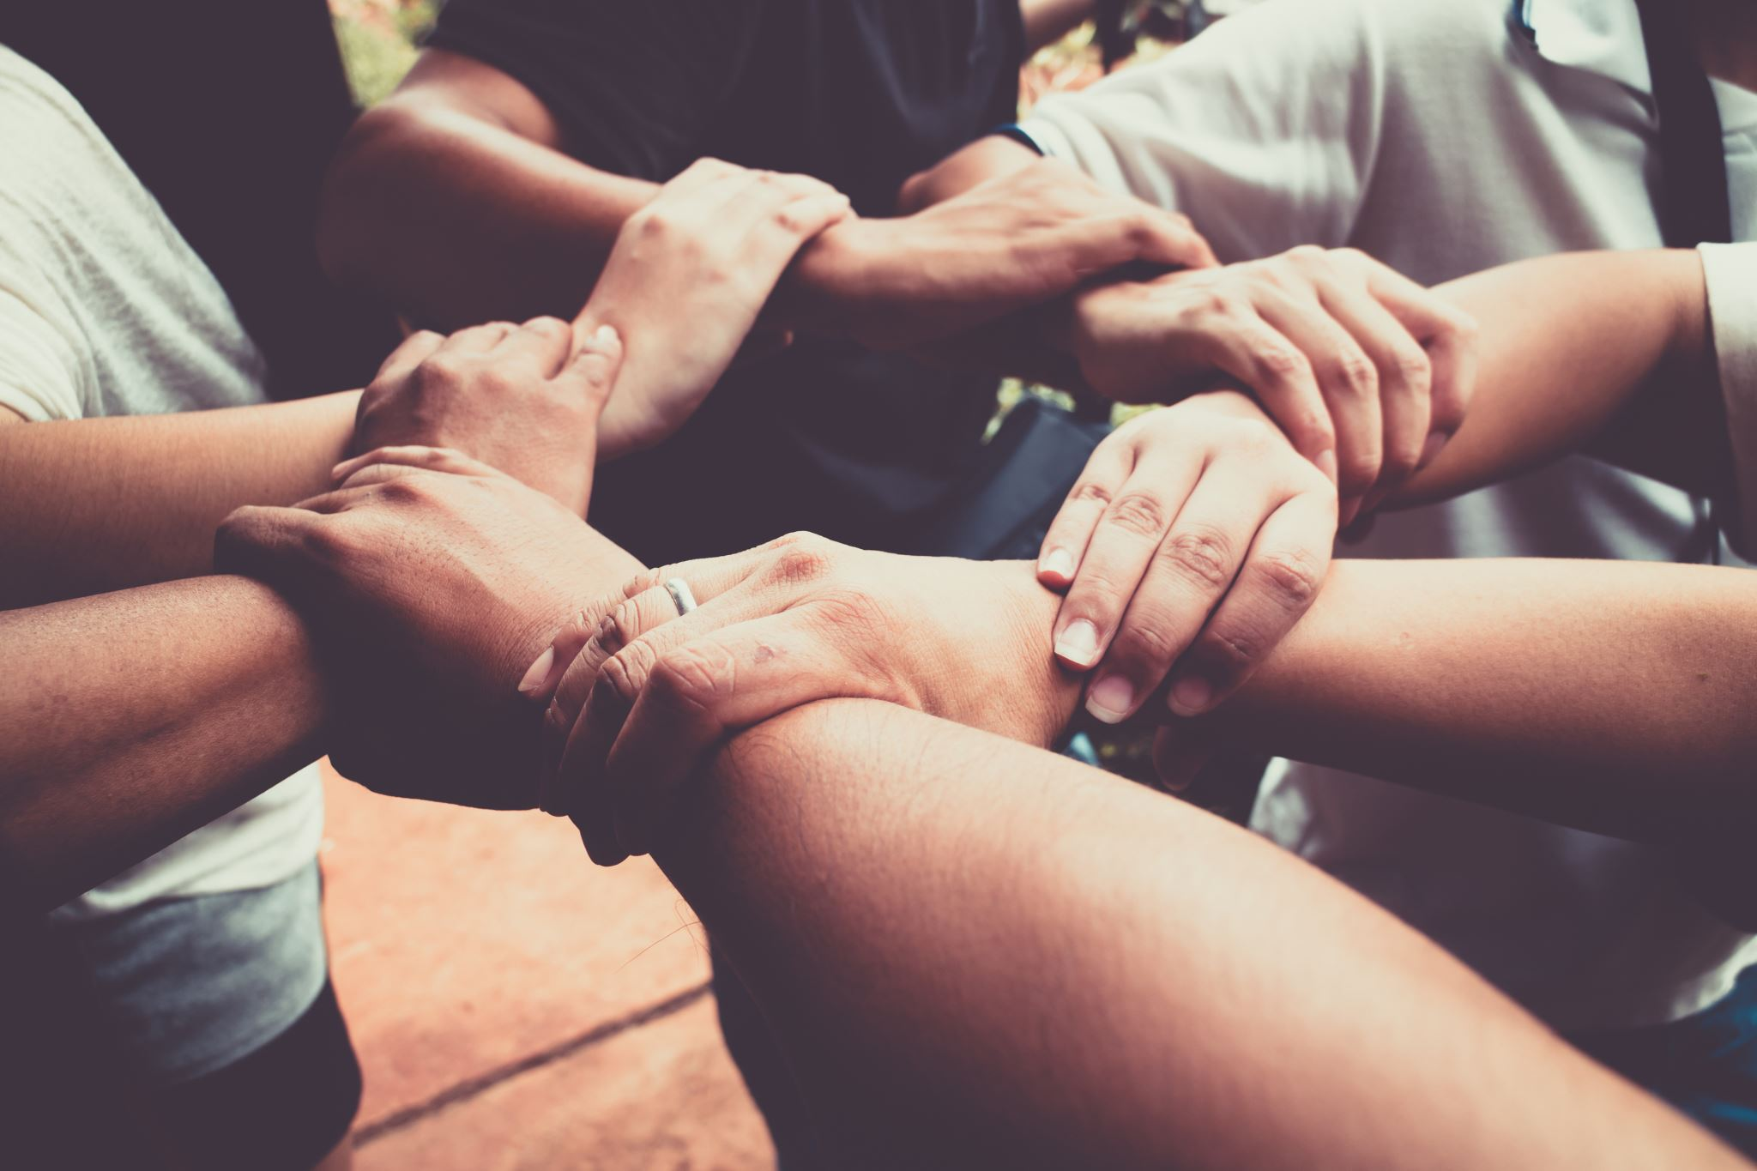
Conclusion
Final Thoughts:
  The project is crucial for breaking the cycle of poverty and ill-health in the Sundarbans.
  Collaboration, community engagement, and sustained efforts are key to success.

